Slide 1

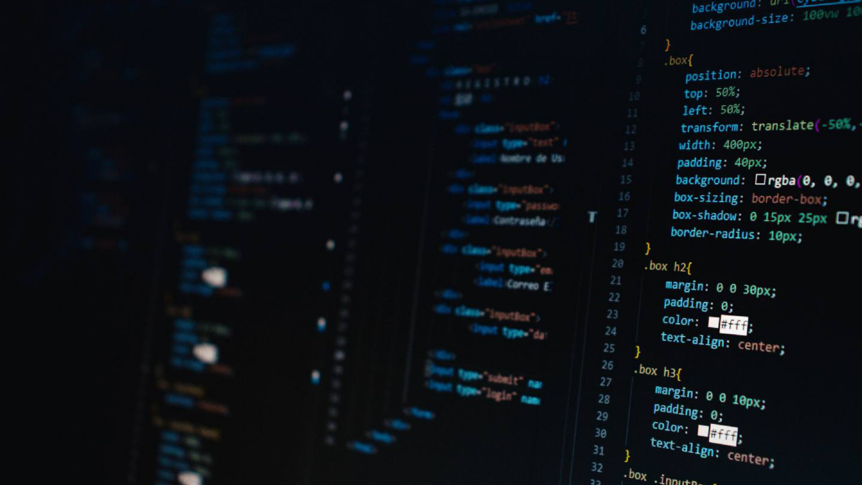

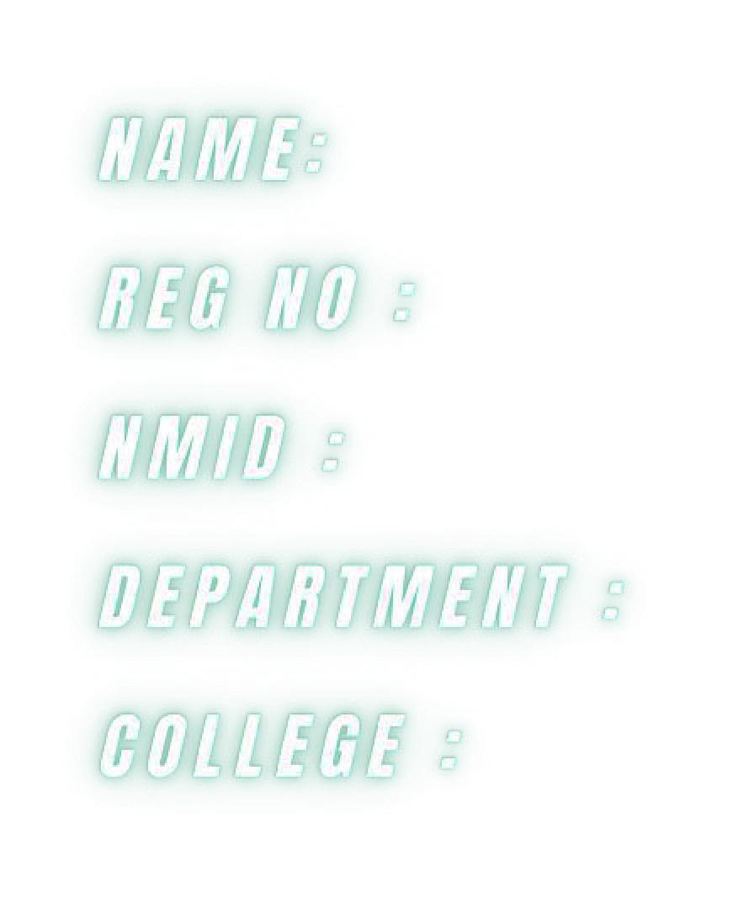
Bhavadharani N
2428B0260
asbru262428b0260
B.sc computer science with
Data Analysis
SNMV college of arts and science

Slide 2



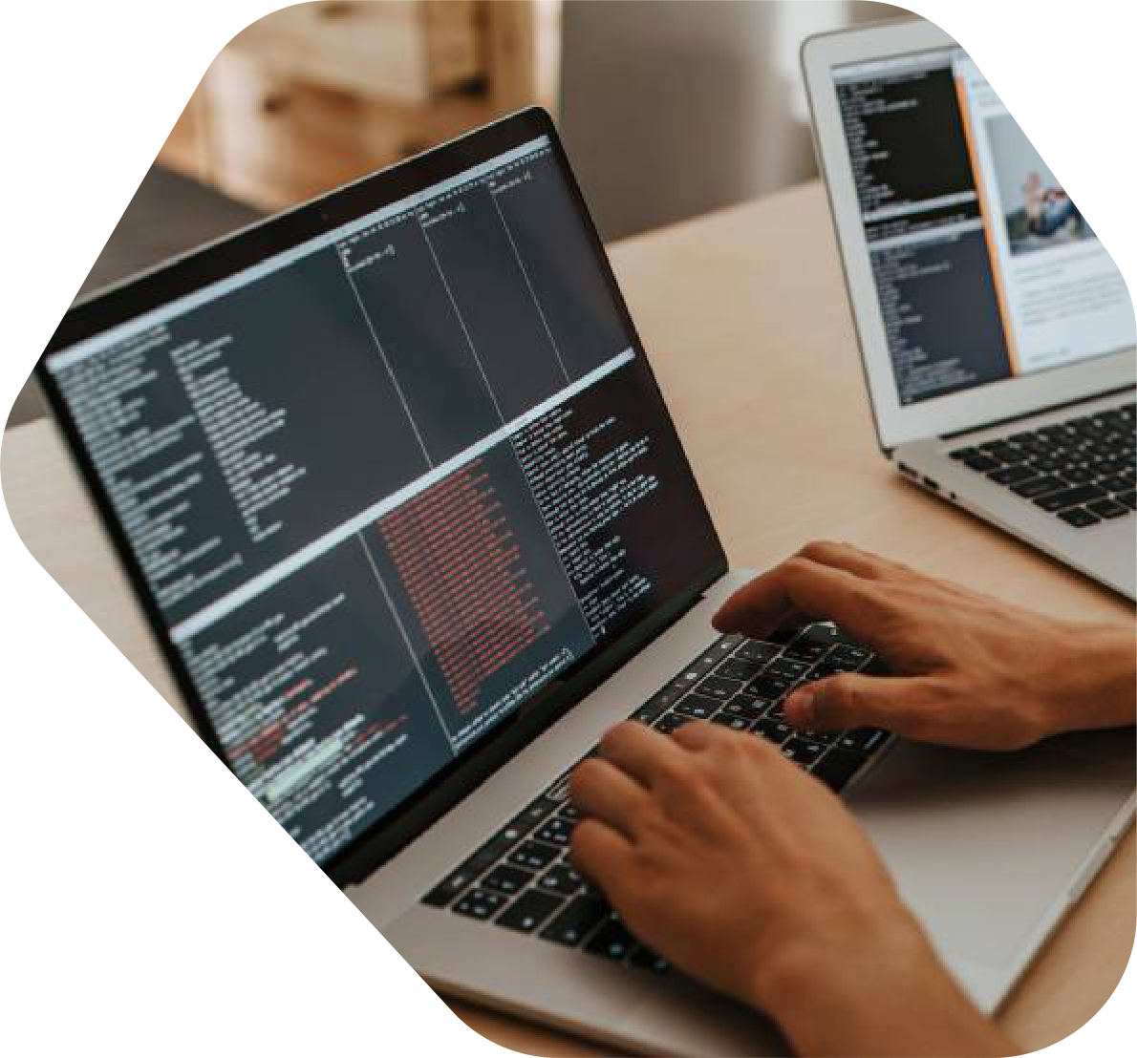



Slide 3






Problem Statement
Project Overview
End Users
Tools and Technologies
Portfolio design and Layout
Features and Functionality
Results and Screenshots
Conclusion
Github Link

Slide 4

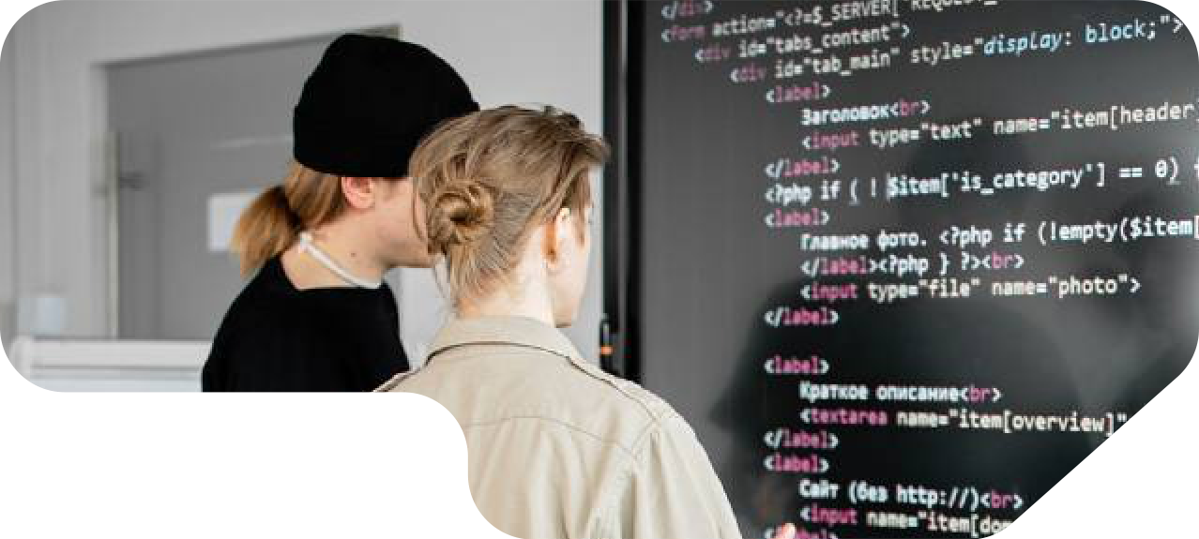

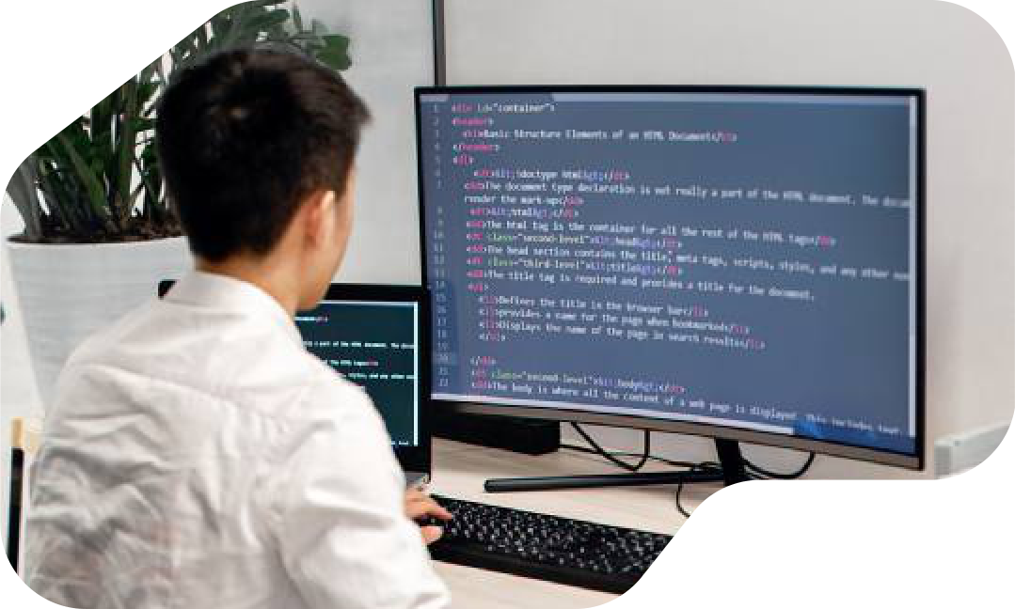



In the modern digital era, relying only on traditional
resumes is not enough to showcase an individual’s
skills, projects, and achievements. Recruiters and
collaborators often look for an online presence
that reflects both technical expertise and creativity.
Without
a
personal
digital
space,
it
becomes
difficult to stand out in a competitive field. To
overcome this challenge, this project focuses on
developing a personal portfolio website , providing
an organized and professional platform to present
qualifications, certifications, and projects in an
easily accessible manner.

Slide 5







The Personal Portfolio Website is developed for
Bhavadharani to build a strong online presence and
showcase academic qualifications, technical skills,
certifications, and projects. It acts as a digital resume
that is easily accessible and helps recruiters and
collaborators understand professional abilities at a
glance. Designed with a responsive layout, the
portfolio ensures smooth viewing across devices
while presenting information in a clear and organized
manner.

Slide 6







Recruiters and
Employers – to
Peers and
evaluate skills,
Collaborators – to
qualifications, and
connect for academic
projects for job
or professional
opportunities.
projects.
General Audience –
Faculty Members and
anyone interested in
Evaluators – to assess
learning more about
technical knowledge
the professional profile
and project work.
of Almas Begam.

Slide 7




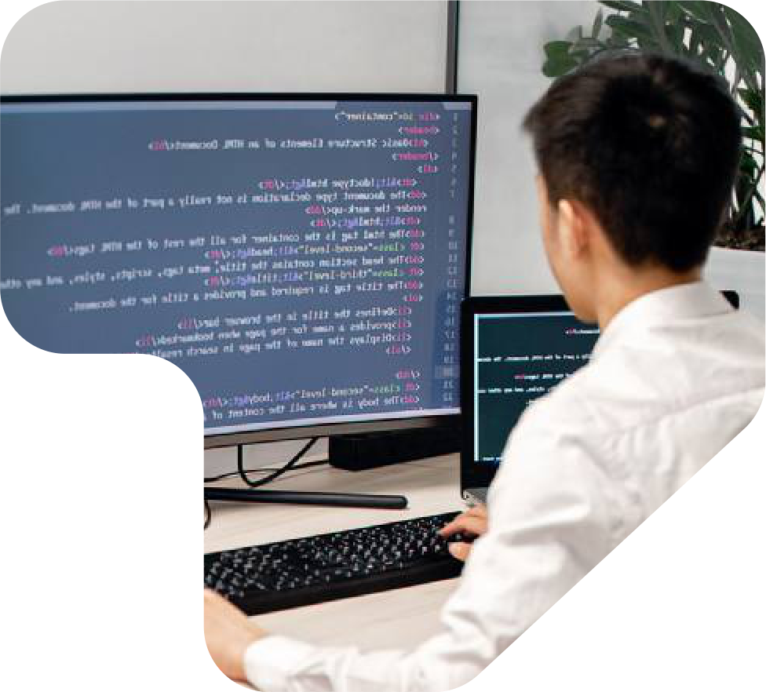


Frontend Development:
HTML5 – for structuring the web pages.
CSS3 – for styling and layout design.
JavaScript – for interactivity and dynamic behavior.
Version Control & Hosting:
Git & GitHub – for version control and project hosting.
Design Tools:
Canva / Figma – for creating and refining UI/UX designs.
Techniques:
Responsive Web Design – ensuring compatibility across devices.
User-Centered Design – focusing on readability, accessibility, and professional
presentation.
Code Optimization – clean, reusable, and well-structured code for performance

Slide 8






H o m e P a g e – A b r i e f i n t r o d u c t i o n w i t h n a m e , t i t l e , a n d a p r o f e s s i o n a l
The portfolio website is designed with a
t a g l i n e .
clean and modern layout to ensure
A b o u t M e – S h o w c a s i n g p e r s o n a l b a c k g r o u n d , e d u c a t i o n , a n d c a r e e r
professionalism and user-friendly
g o a l s .
S k i l l s – H i g h l i g h t i n g t e c h n i c a l a n d s o f t s k i l l s i n a n o r g a n i z e d f o r m a t .
navigation. The design follows a
P r o j e c t s – D i s p l a y i n g a c a d e m i c a n d p e r s o n a l p r o j e c t s w i t h
responsive web structure, making it
d e s c r i p t i o n s .
accessible across desktops, tablets,
C e r t i f i c a t i o n s – L i s t i n g r e l e v a n t c e r t i f i c a t i o n s a n d a c h i e v e m e n t s .
and mobile devices.
C o n t a c t S e c t i o n – P r o v i d i n g e m a i l , p h o n e , a n d s o c i a l m e d i a l i n k s f o r
e a s y c o m m u n i c a t i o n .

Slide 9


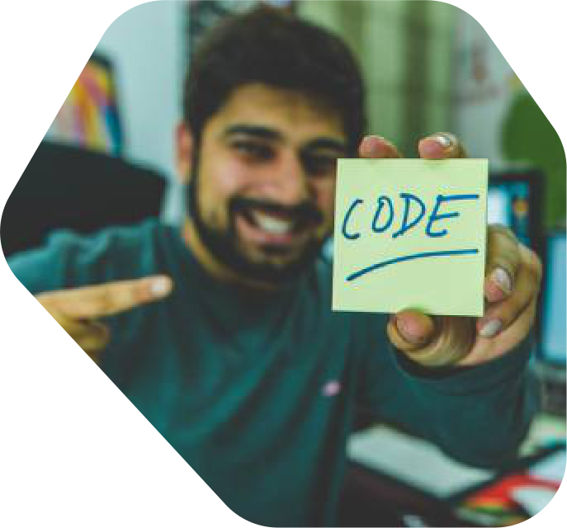




Responsive Design – Works smoothly on desktop, tablet, and mobile.
Home & About Sections – Introduction, background, and career goals.
Skills & Projects – Showcases technical abilities and academic work.
Certifications – Displays completed certifications and achievements.
Contact Section – Provides email, phone, and social media links.
Easy Navigation – Clean and user-friendly menu system.

Slide 10


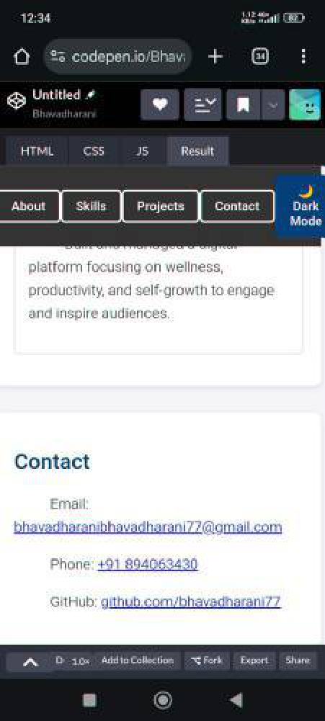
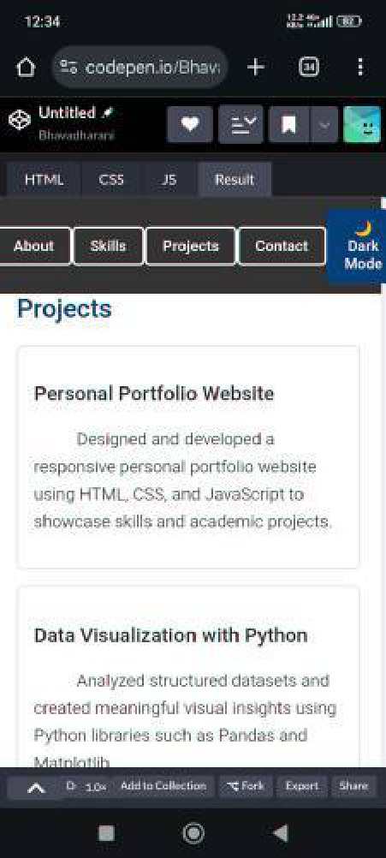
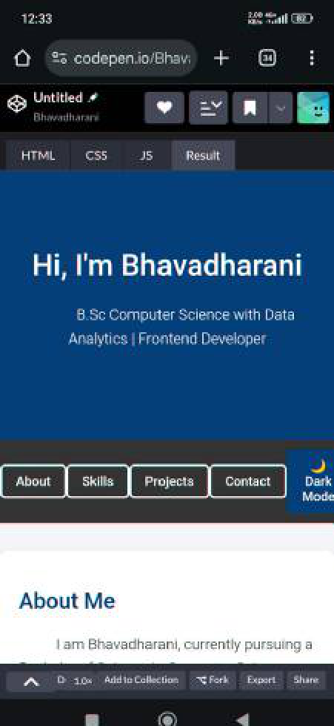
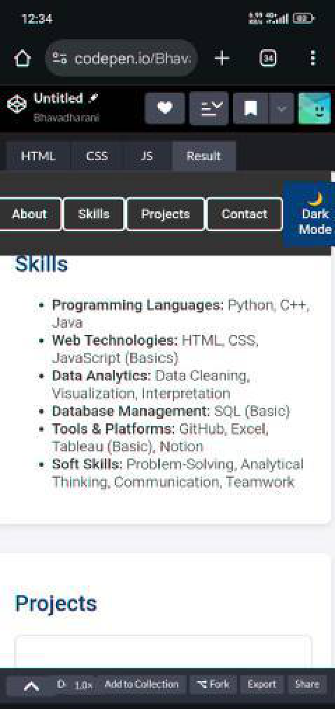



Slide 11




The Personal Portfolio Website successfully
provides a professional platform for Almas Begam
to showcase academic achievements, technical
skills, certifications, and projects in an organized
manner. It serves as a digital resume, enhancing
visibility and accessibility for recruiters, peers, and
collaborators. With its responsive design and user-
friendly layout, the portfolio strengthens personal
branding and supports future career opportunities.

Slide 12










Thank you for taking the time
+91
894063843
to view my portfolio.
0
I
truly
appreciate
your
bhavadharanibhavadharan
attention and support.
i77@gmail.com
Looking
forward
to
your
Arowwai
feedback and suggestions!
Shri Nehru Maha Vidyalaya College of Arts
Industries
and Science

